Slide 1

Python Data Types
PY
Python Is FUN

Slide 2

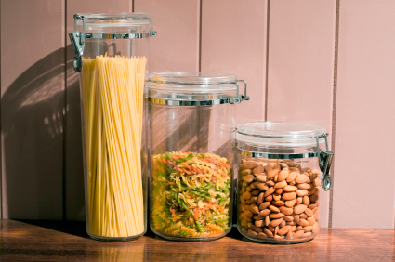
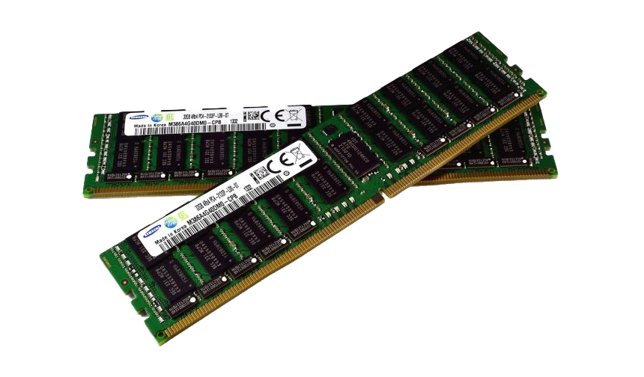
What is Variable?
Variable is a name that is used to refer to memory location. Python variable is also known as an identifier and used to hold value.
A variable can hold different types of values. For example, a person's name must be stored as a string whereas its id must be stored as an integer.
Python provides various standard data types that define the storage method on each of them. The data types defined in Python are given below.

Slide 3
What is Data Type?
Data type is used by the complier to identify any variable
Variables can hold values, and every value has a data-type.
The interpreter implicitly binds the value with its type.
Python is a dynamically typed language; hence we do not need to define the type of the variable while declaring it.
Types of Data types in python :-
Numbers
Sequence Type
Boolean
Set
Dictionary

Slide 4
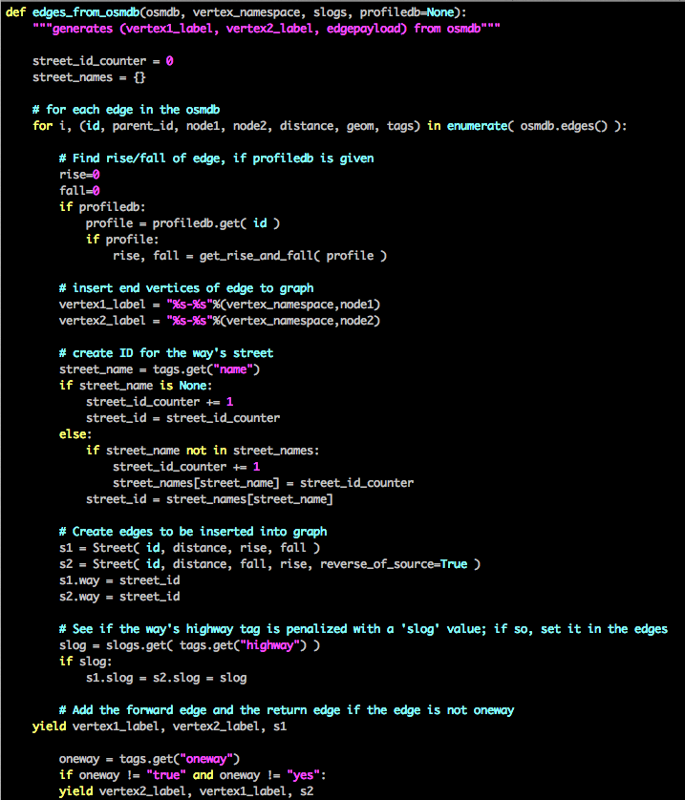
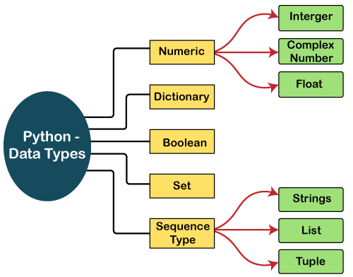

Slide 5
Numeric
Number stores numeric values. The integer, float, and complex values belong to a Python Numbers data-type.
Integer
Integer value can be any length such as integers 10, 2, 29, -20, -150 etc. Python has no restriction on the length of an integer. Its value belongs to int
Float
Float is used to store floating-point numbers like 1.9, 9.902, 15.2, etc. It is accurate up to 15 decimal points.
Complex
A complex number contains an ordered pair, i.e., x + iy where x and y denote the real and imaginary parts, respectively. The complex numbers like 2.14j, 2.0 + 2.3j, etc.

Slide 6
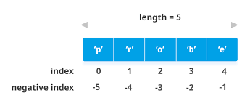
Sequence Type
String
The string can be defined as the sequence of characters represented in the quotation marks
eg = “ Hello , World ” or “ My name is Vinit ”
List
Python Lists are similar to arrays in C. However, the list can contain data of different types. The items stored in the list are separated with a comma (,) and enclosed within square brackets [].
eg = [ 1,2,3,4,5] or [“vinit”, 1, 2, ”Ananyya”, 3.42]
Tuple
A tuple is similar to the list in many ways. Like lists, tuples also contain the collection of the items of different data types. The items of the tuple are separated with a comma (,) and enclosed in parentheses ().
eg = (‘hi’, ‘python’, ‘vinit’, 1 , 2)

Slide 7
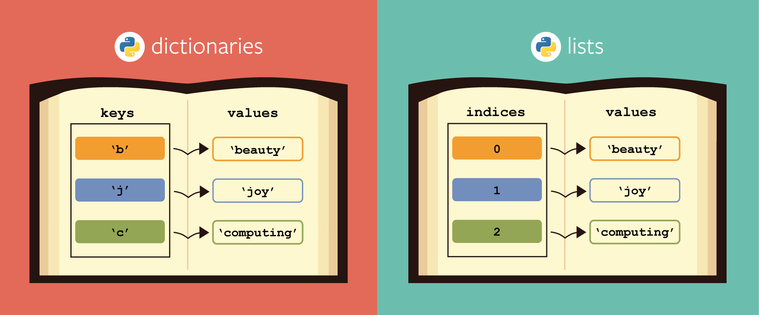
Dictionary
Dictionary is an unordered set of a key-value pair of items.
It is like an associative array or a hash table where each
key stores a specific value.
Key can hold any primitive data type, whereas value is an arbitrary Python object.
d = {‘b’:’beauty’, ’j’:’joy’, ’c’:’computing'}

Slide 8
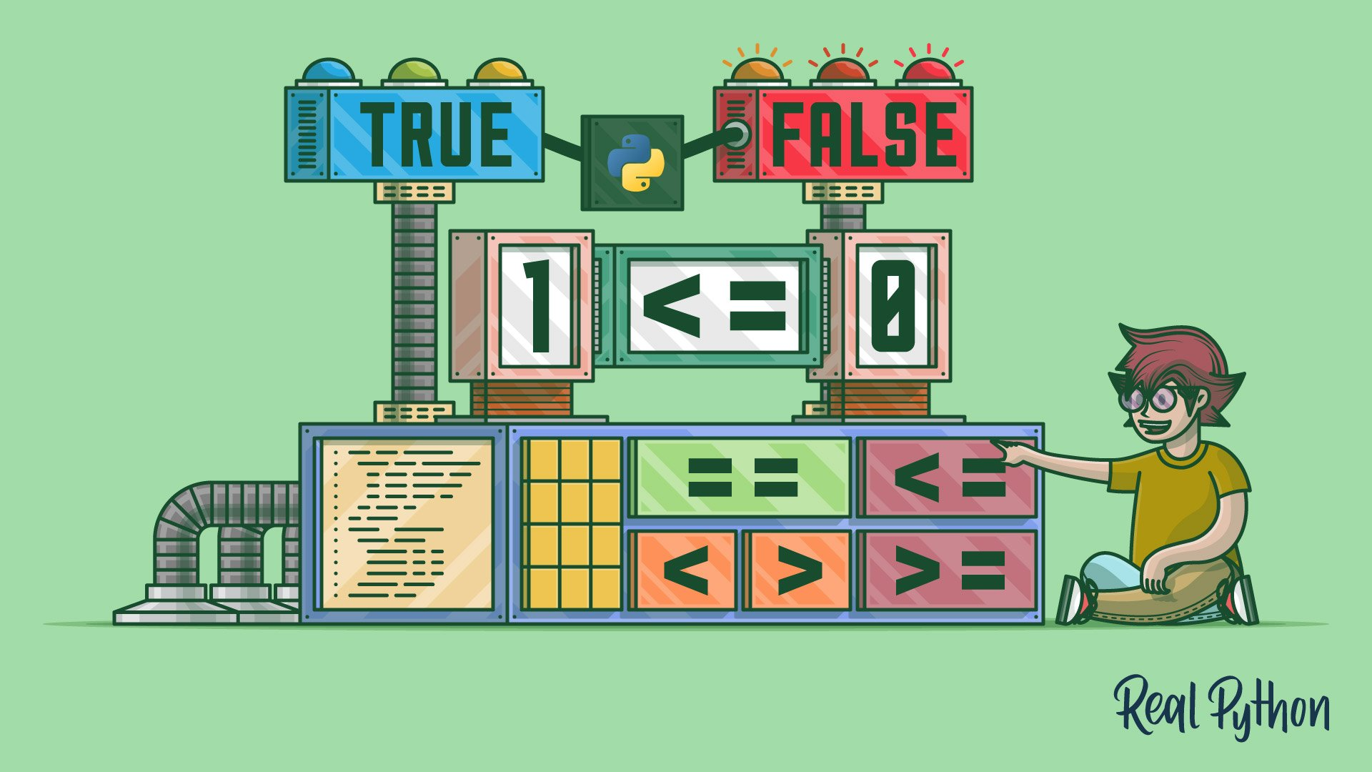
Boolean
Boolean type provides two built-in values, True and False.
These values are used to determine the given statement true or false.
It denotes by the class bool. True can be represented by any non-zero value or 'T' whereas false can be represented by the 0 or 'F'.

Slide 9
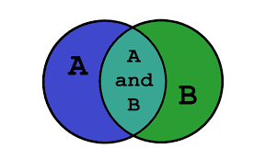
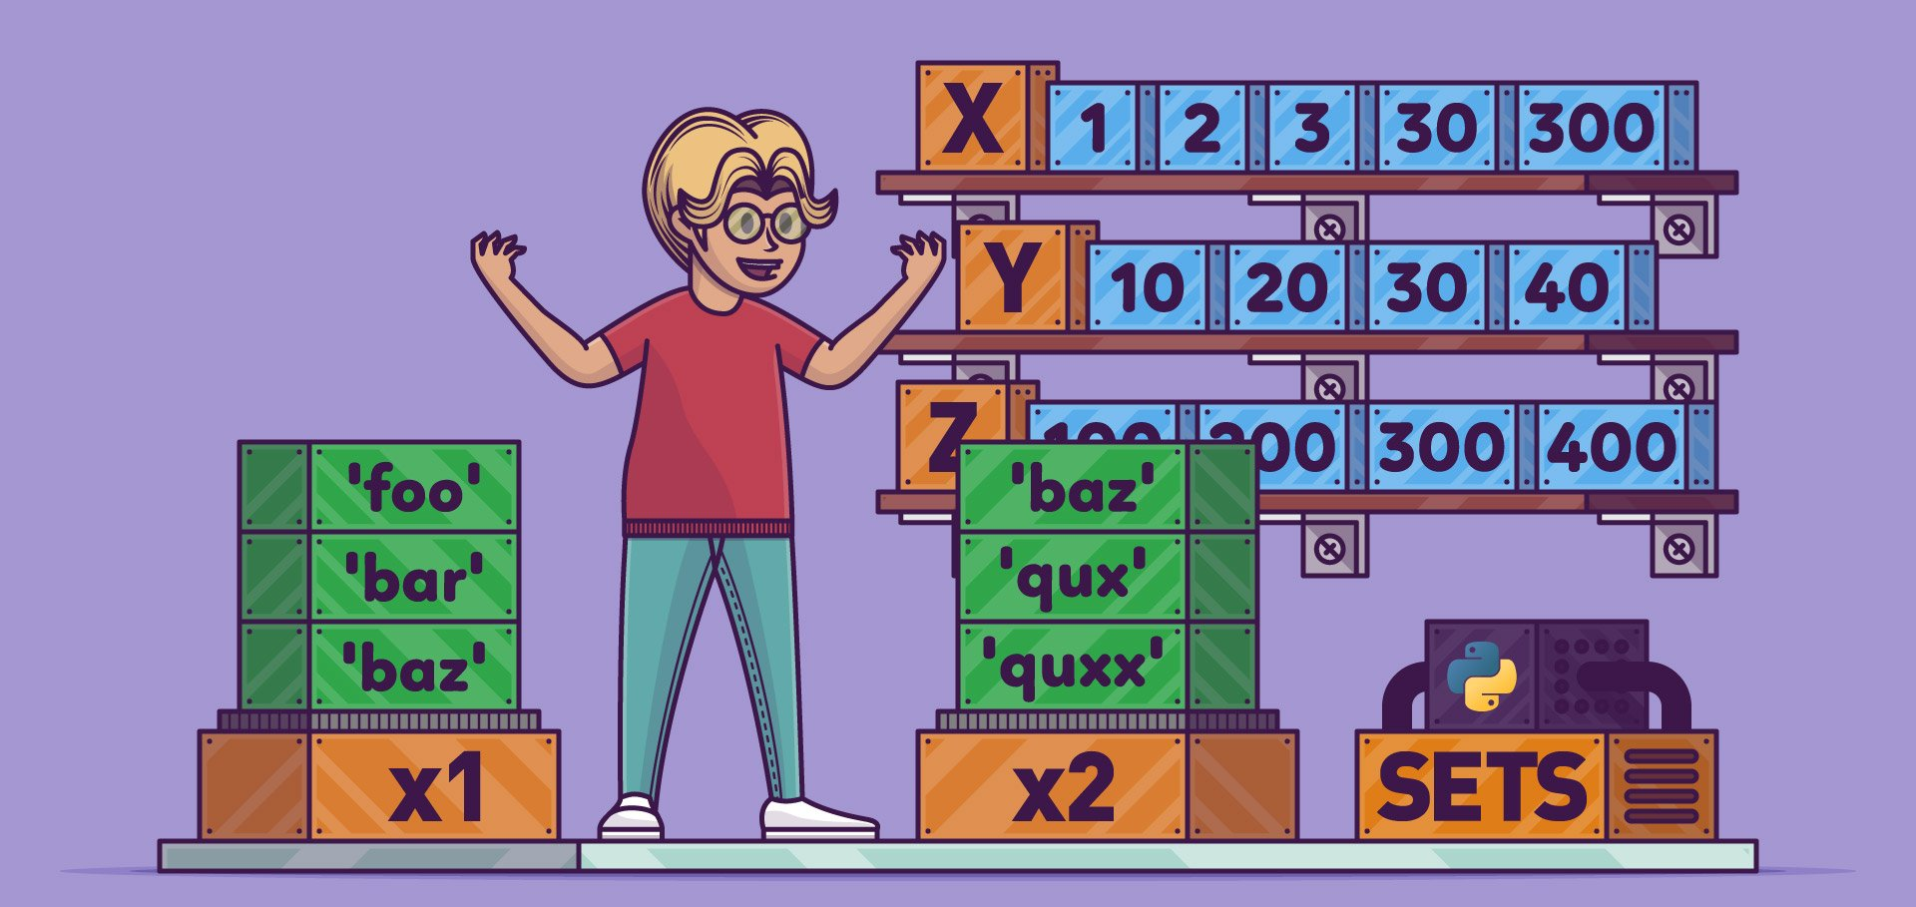
Set
Python Set is the unordered collection of the data type. It is iterable, mutable(can modify after creation), and has unique elements
In set, the order of the elements is undefined; it may return the changed sequence of the element. The set is created by using a built-in function set(), or a sequence of elements is passed in the curly braces and separated by the comma.

Slide 10
Thank You
PY
Python Is FUN
- By Vinit

